Slide 1
I N C O M E T A X C A L C U L T O R W E B S I T E
->ARYAN SHARMA
->Vasvi Bali
->CSE-15

Slide 2


O B J E C T I V E
1st
Develop an intuitive and user-friendly income tax calculator using HTML, CSS, JS, and
Python
2nd
Simplify the process of calculating income tax for individuals and businesses.

Slide 3


Technology Stack
Python is commonly used for developing websites and software, task automation, data analysis, and data visualisation
PYTHON
HTML
HTML : It defines the content and structure of web content.
JavaScript is an open-source programming language. It is designed for creating web- centric applications.JavaScript is integrated with HTML and CSS
JAVASCRIPT
Css
CSS : It used for styling of a document written in a markup language such as HTML

Slide 4
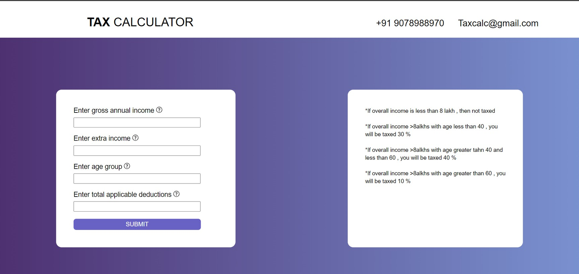
U S E R I N T E R F A C E (U I)

Slide 5
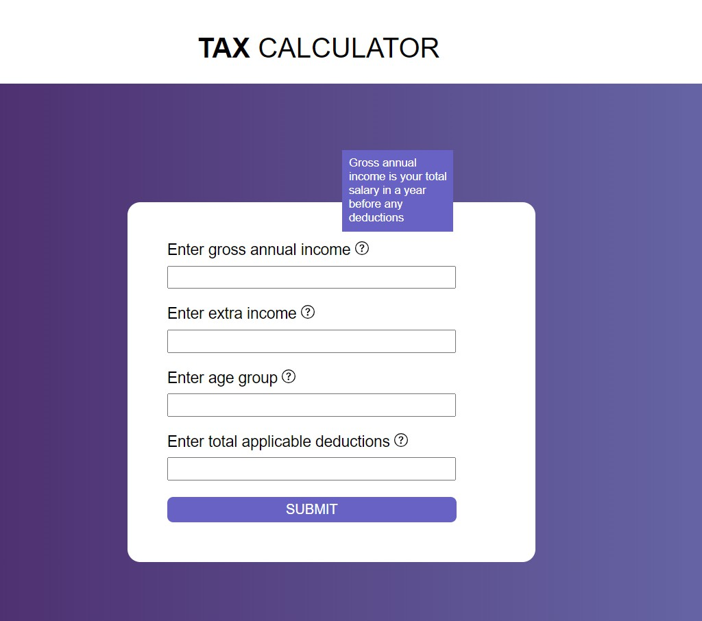
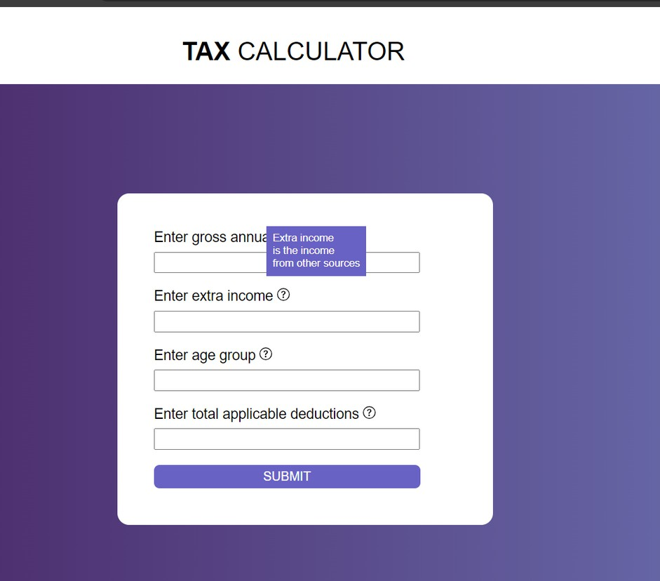
V I S U A L S

Slide 6
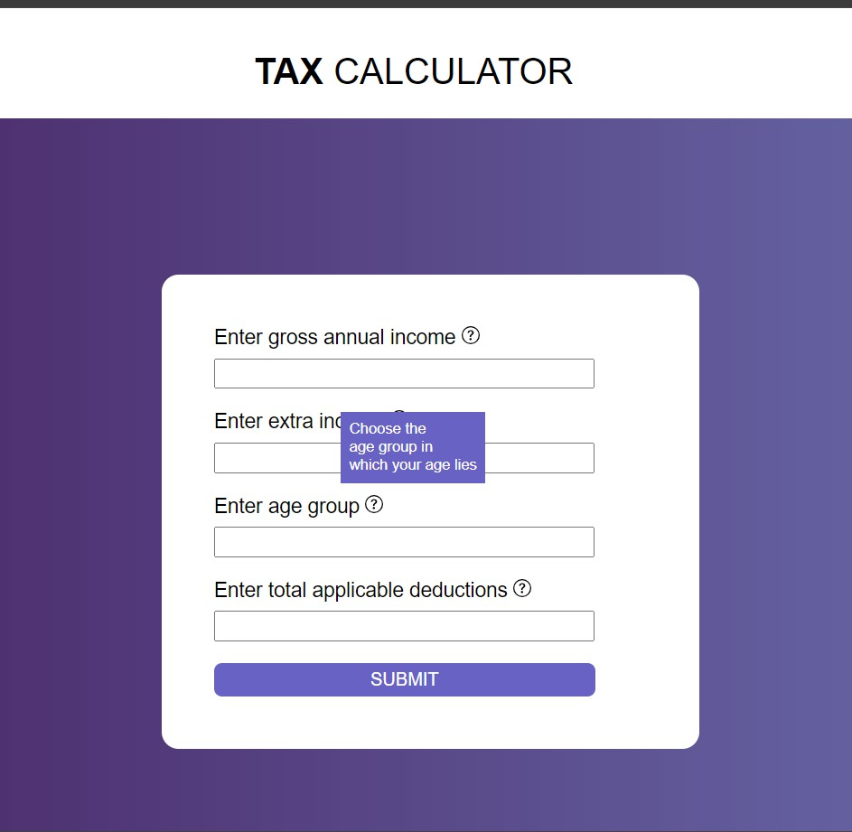
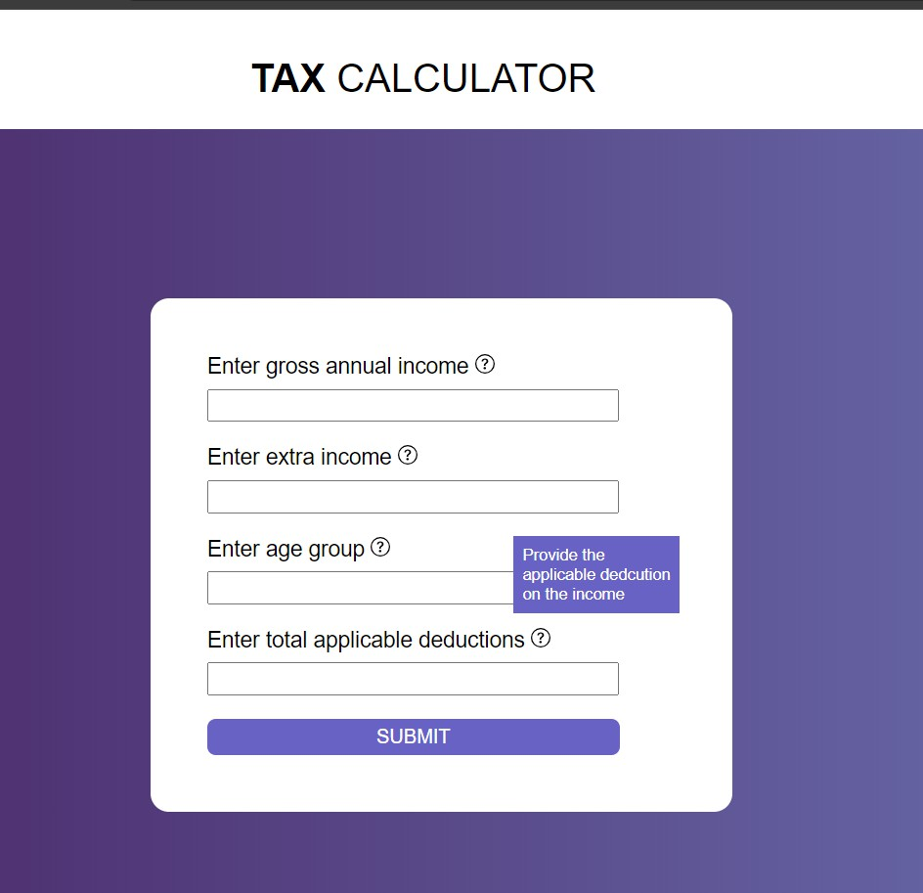
V I S U A L S

Slide 7
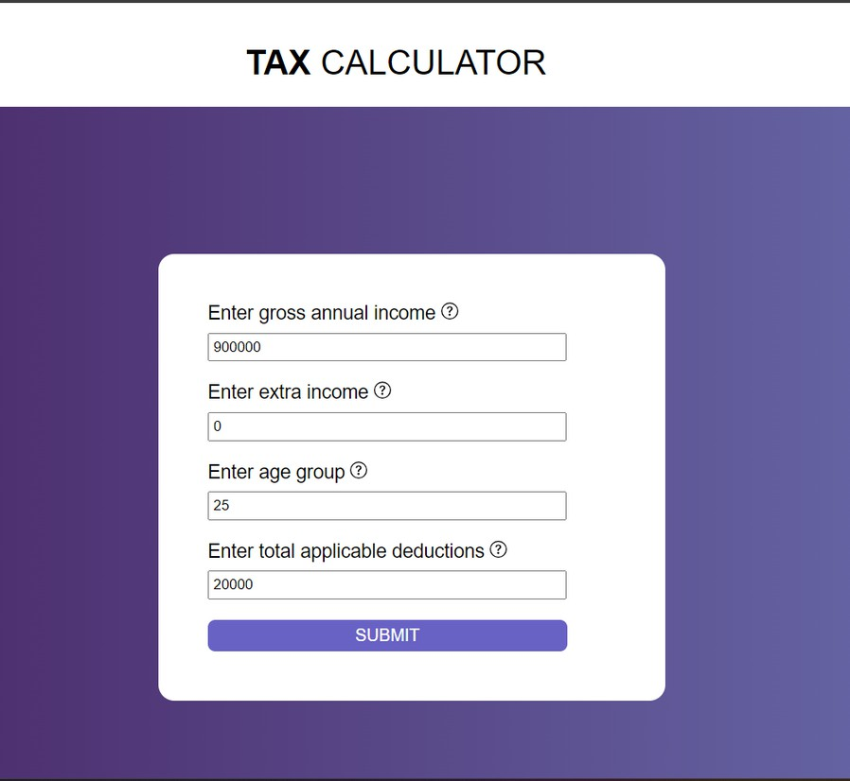
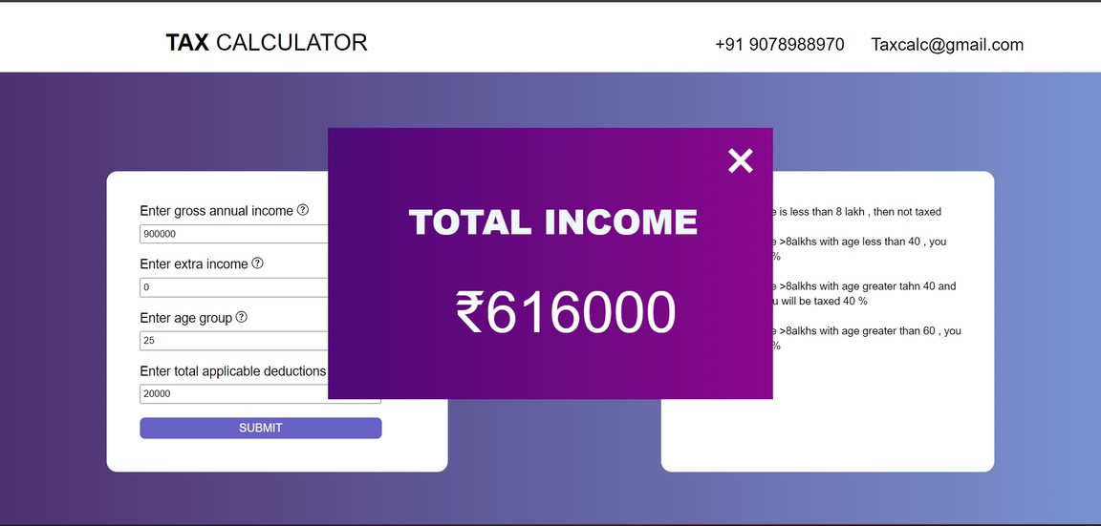
F U N C T I O N A L I T Y

Slide 8

1)Multi-Language Support: Provide support for multiple languages to make thIS accessible to users worldwide.
CURRENCY: Adding different currencies into it for worldwide users.
Interactive Tutorials: Provide interactive tutorials or quizzes to enhance user understanding of tax calculation.

Slide 9
T H A N K Y O U

